Slide 1
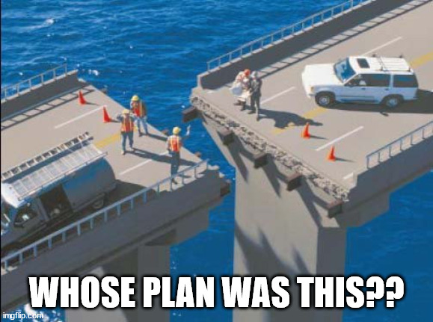
Data Management Plans (DMPs)
source
Nick Rochlin, Data Science Librarian
UVic Libraries

Slide 2
Session Overview
What is a data management plan (DMP)?
High-level overview of DMP sections
Introduction to the DMP Assistant

Slide 3
Note
This session is not going to go into the full details of a DMP.
The goal is to introduce the concept of a DMP at a high level, and throughout the workshop we will be addressing each question with concrete activities to contextualize the answers and decision-making processes.
By the end of the final block we will have completed a DMP.

Slide 4

What is a DPM?
source

Slide 5
What is a DMP?
A formal document that is completed prior to beginning a research project, that outlines how research data will be managed during and after a project’s completion.
Sections of questions to address various aspects of data management.
Is a living document that can be updated throughout a project, as necessary.

Slide 6
Value of a DMP
Help you identify services/tools/workflows/practices best suited to your work
Save you time and headaches
Enable the preservation and reuse of your data
Promote transparency and reproducibility of research

Slide 7

DMP Assistant
Canadian tool for preparing DMPs
Step-by-step questions about data management divided by sections
Built-in discipline- and institutionally-specific templates
Features publicly shared DMPs as examples
source

Slide 8
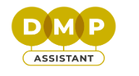
UVic DMP Template
source

Slide 9
UVic DMP Template Sections
Data Collection
Documentation and Metadata
Storage and Backup
Preservation
Sharing and Reuse
Indigenous Data Sovereignty
Sensitive Data and Legal Compliance
Responsibilities and Resources

Slide 10
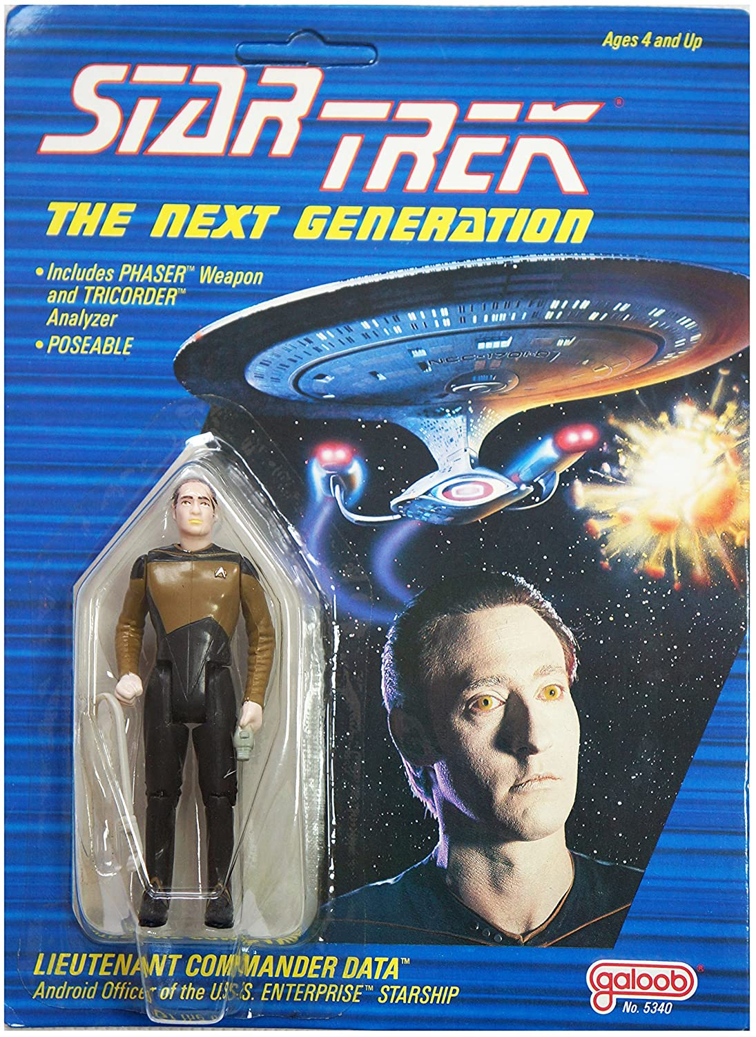
Section 1: Data Collection
What types of research data will you collect, link to, acquire and/or record?
What file formats will your data be collected and saved in?
Does the data you will be working with contain sensitive information that requires data protection considerations?
source

Slide 11
Section 1: Data Collection
Describe how you will organize, name, and version-control your files to help you and others understand your data.
Describe related tools and software needed to access, manipulate, and analyze the data.
source

Slide 12
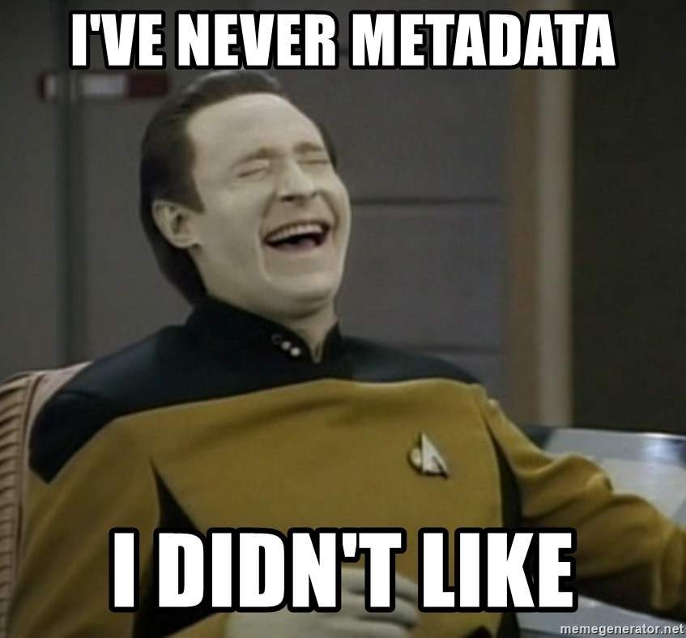
Section 2: Documentation and Metadata
What documentation will be created for the data to be read and interpreted correctly in the future?
How will you make sure the documentation is created or captured consistently throughout your project?
Do you plan to use a metadata standard and/or tools to document and describe your data? If so, please list here.
source

Slide 13
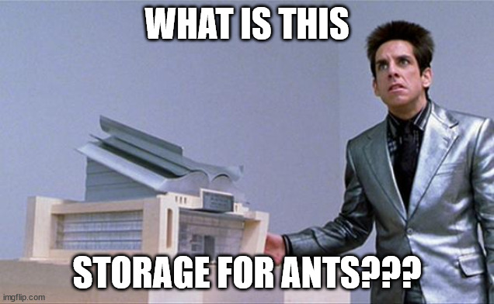
Section 3: Storage and Backup
What are the anticipated storage requirements for your data, in terms of storage space (in megabytes, gigabytes, terabytes, etc.) and the length of time you will be storing it?
How and where will your data be stored and backed up during your research project?
source

Slide 14
Section 3: Storage and Backup
If applicable, where are hardcopy notebooks and physical samples going to be physically stored?
How will the research team and other collaborators access, modify, and contribute data throughout the project?
source

Slide 15
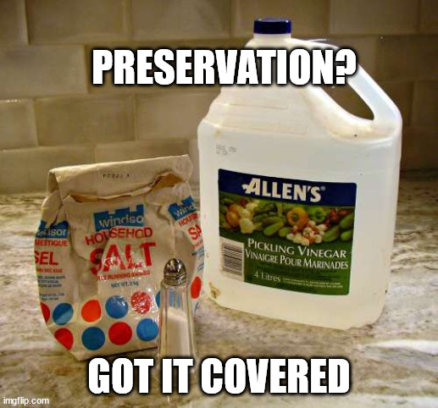
Section 4: Preservation
What data, if any, will be preserved for the long term after the completion of the project?
Where will you deposit your data for long-term storage at the end of your research project?
Indicate how you will ensure your data is preservation friendly.
source

Slide 16
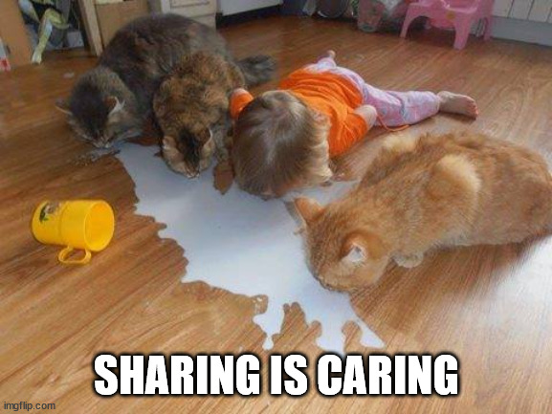
Section 5: Sharing and Reuse
What data will you be sharing and in what form? (e.g. raw, processed, analyzed, final).
How will you be sharing your data? (e.g. institutional repository, a specialized data archive, informal/on-request sharing).
source

Slide 17
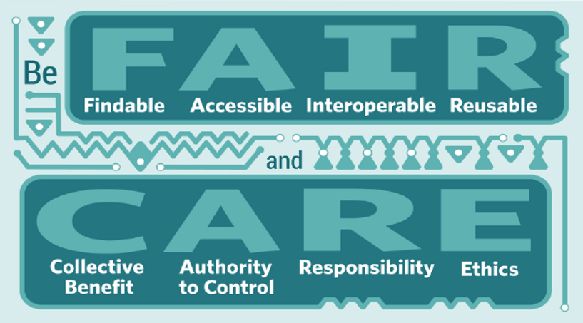
Section 6: Indigenous Data Sovereignty
If you are working with data concerning First Nations, Inuit, or Métis or other Indigenous peoples or territories, describe in detail how this data management plan respects principles of Indigenous data sovereignty specific to the partners involved.
Describe processes that have been implemented and that will be used in the future to ensure that partners from First Nations, Inuit, Métis nations or other Indigenous partners or groups consent to how their data is managed over the research lifecycle.
source

Slide 18
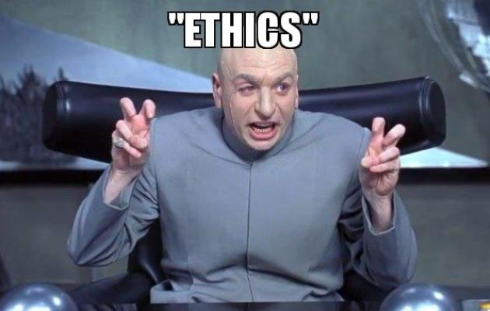
Section 7: Sensitive Data and Legal Compliance
If your research project includes sensitive data, how will you ensure that it is securely managed and accessible only to approved members of the project? Describe factors affecting subsequent access, distribution, or reuse of data.
Will your research data be analyzed, now or in the future, by other persons for purposes other than explained in this application?
source

Slide 19
Section 7: Sensitive Data and Legal Compliance
How will you obtain consent from the participants for future data analysis by other researchers? What strategies will you undertake to address secondary uses of sensitive data?
How will you manage legal, ethical, and intellectual property issues? Include here a description concerning ownership, licensing, and intellectual property rights of the data. Any terms of reuse should be clearly stated, in line with the relevant legal and ethical requirements where applicable (e.g., subject consent, permissions, restrictions, etc.).
source

Slide 20
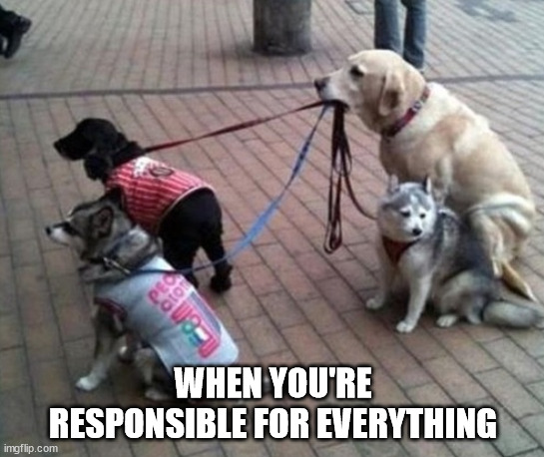
Section 8: Responsibilities and Resources
Identify who will be responsible for managing this project's data during and after the project and the major data management tasks for which they will be responsible.
What fiscal resources will you require to implement your data management plan? What do you estimate the overall cost for data management to be?
source

Slide 21
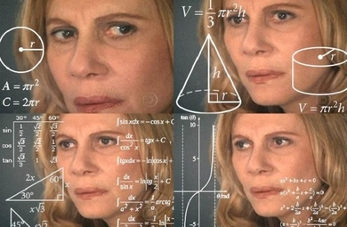
Questions?
source

